Slide 1
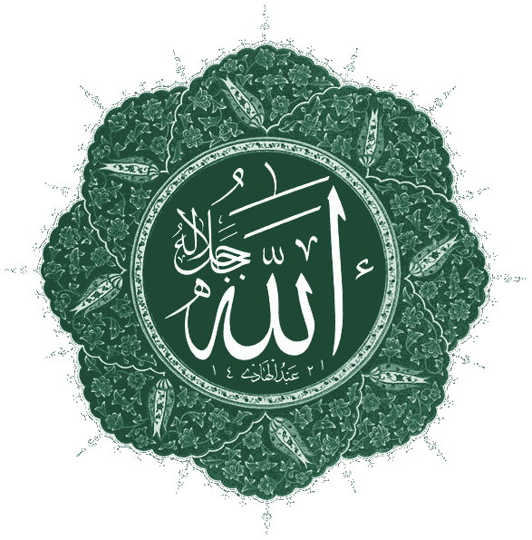
The Rise of Islam
Chapter 10, Section 1

Slide 2
Deserts, Towns, and Trade Routes
The Arabian Peninsula
  A crossroads of three continents: Africa, Asia, Europe.
  Mostly desert with a small amount of fertile land
Notes:
The Arabian Peninsula
A crossroads of three continents:
Africa
Asia
Europe
Mostly desert with a small amount of fertile land

Slide 3
Deserts, Towns, and Trade Routes
Desert and Town Life
  Bedouins, Arab nomads, thrive in the desert.
  Bedouins live in clans, which give support to members.
  Some Arabs settle near oases or market towns.
Notes:
Desert and Town Life
Bedouins, Arab nomads, thrive in the desert.
Bedouins live in clans, which give support to members.
Some Arabs settle near oases or market towns.

Slide 4
Deserts, Towns, and Trade Routes
Crossroads of Trade and Ideas
  Many sea and land trade routes pass through Arabia.
  Trade extends to the Byzantine and Sassanid empires to the north.
Notes:
Crossroads of Trade and Ideas
Many sea and land trade routes pass through Arabia.
Trade extends to the Byzantine and Sassanid empires to the north.

Slide 5
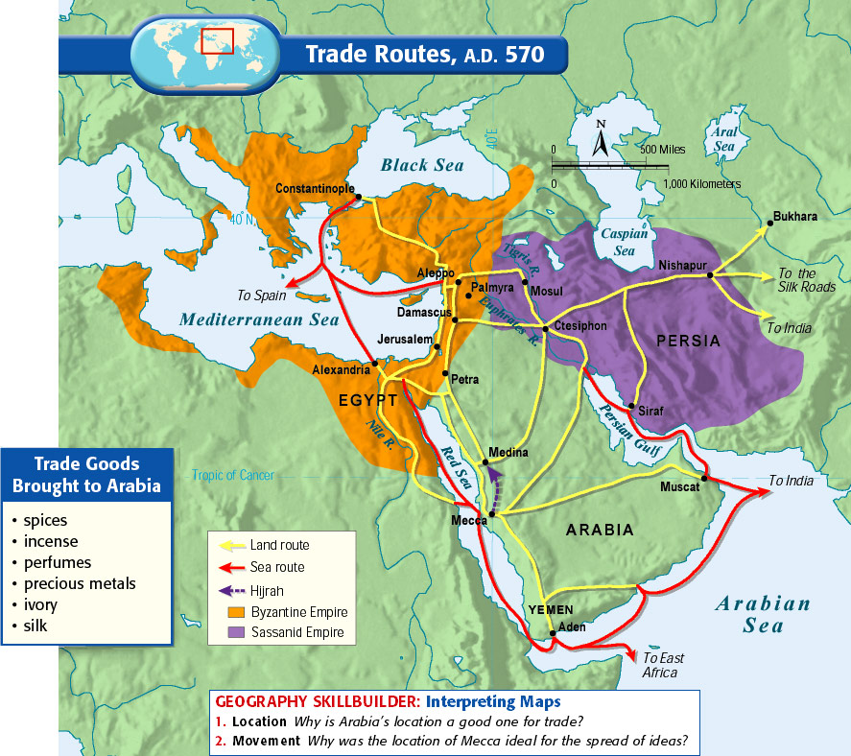

Slide 6
Deserts, Towns, and Trade Routes
Mecca
  Pilgrims come to Mecca to worship at the Ka’aba, and ancient shrine.
  Arabs associate shrine with Hebrew prophet Abraham and monotheism.
  Some tribes worship many gods and spirits, and bring idols to Ka’aba.
  Some Arabs believe in one God—Allah in Arabic
Notes:
Mecca
Pilgrims come to Mecca to worship at the Ka’aba, and ancient shrine.
Arabs associate shrine with Hebrew prophet Abraham and monotheism.
Some tribes worship many gods and spirits, and bring idols to Ka’aba.
Some Arabs believe in one God—Allah in Arabic

Slide 7
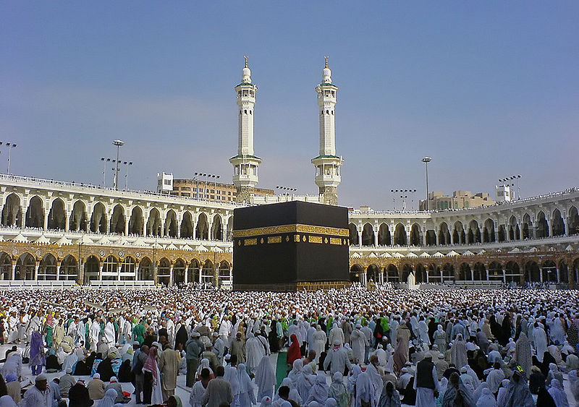

Slide 8
The Prophet Muhammad
Early Life
  Around A.D. 570 Muhammad is born into a powerful Meccan clan.
  He becomes a trader, and marries a wealthy businesswoman, Khadijah.
Notes:
Early Life
Around A.D. 570 Muhammad is born into a powerful Meccan clan.
He becomes a trader, and marries a wealthy businesswoman, Khadijah.

Slide 9
The Prophet Muhammad
Revelations
  By age 40, Muhammad spends much time in prayer and meditation
  He claims to hear the angel Gabriel tell him he is a messenger of Allah.
  Muhammad found the religion of Islam—meaning “submission to the will of Allah”
  Many join him and become Muslim—meaning “one who has submitted.”
Notes:
Revelations
By age 40, Muhammad spends much time in prayer and meditation
He claims to hear the angel Gabriel tell him he is a messenger of Allah.
Muhammad found the religion of Islam—meaning “submission to the will of Allah”
Many join him and become Muslim—meaning “one who has submitted.”

Slide 10
The Prophet Muhammad
The Hijrah
  Muhammad’s followers are attacked; together they leave Mecca in 622.
  Hijrah was the Muslim migration from Mecca to Yathrib (renamed Medina).
Notes:
The Hijrah
Muhammad’s followers are attacked; together they leave Mecca in 622.
Hijrah was the Muslim migration from Mecca to Yathrib (renamed Medina).

Slide 11
The Prophet Muhammad
The Hijrah (continued)
  Muhammad attracts many more followers and becomes a great leader.
    Political leader—joins Jews and Arabs of Medina in a single community.
    Religious leader—draws more converts to Islam.
    Military leader—tackles growing hostilities between Mecca and Medina
Notes:
The Hijrah (continued)
Muhammad attracts many more followers and becomes a great leader.
Political leader—joins Jews and Arabs of Medina in a single community.
Religious leader—draws more converts to Islam.
Military leader—tackles growing hostilities between Mecca and Medina

Slide 12
The Prophet Muhammad
Returning to Mecca
  In 630, Muhammad and 10,000 followers return to Mecca
  Meccan leaders surrender.
  Muhammad destroys idols in the Ka’aba.
  Meccans convert to Islam.
  Muhammad unifies Arabian Peninsula.
Notes:
Returning to Mecca
In 630, Muhammad and 10,000 followers return to Mecca
Meccan leaders surrender.
Muhammad destroys idols in the Ka’aba.
Meccans convert to Islam.
Muhammad unifies Arabian Peninsula.

Slide 13
The Beliefs and Practices of Islam
Islam
  The main teaching of Islam is that there is only one god, Allah.
  People are responsible for their own actions; there is good and evil.
  Islamic monument in Jerusalem—Dome of the Rock.
    It is the oldest existing Islamic building in the world.
    Muslims believe Muhammad rose to heaven here to learn Allah’s will.
    Jews believe Abraham was prepared to sacrifice son Isaac at that same site.
Notes:
Islam
The main teaching of Islam is that there is only one god, Allah.
People are responsible for their own actions; there is good and evil.
Islamic monument in Jerusalem—Dome of the Rock.
Muslims believe Muhammad rose to heaven here to learn Allah’s will.
Jews believe Abraham was prepared to sacrifice son Isaac at that same site.

Slide 14
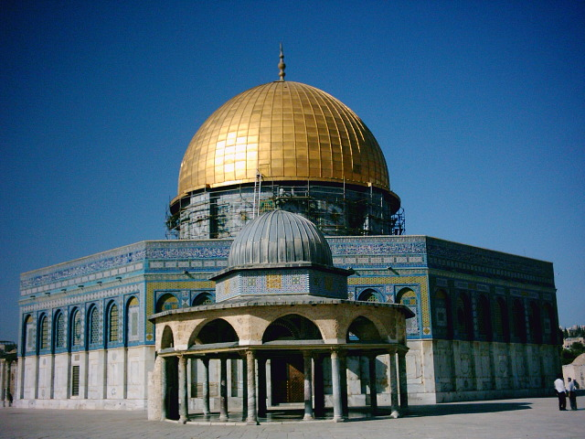
The Dome of the Rock on the Temple Mount in Jerusalem.

Slide 15
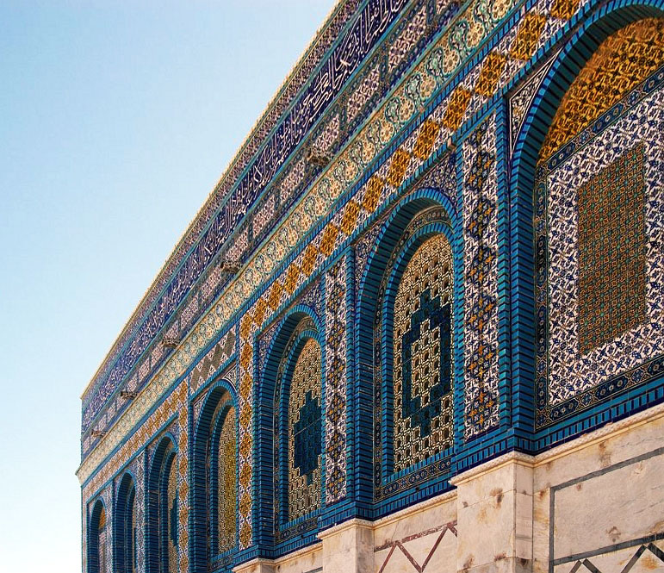
Exterior detail of the Dome of the Rock

Slide 16
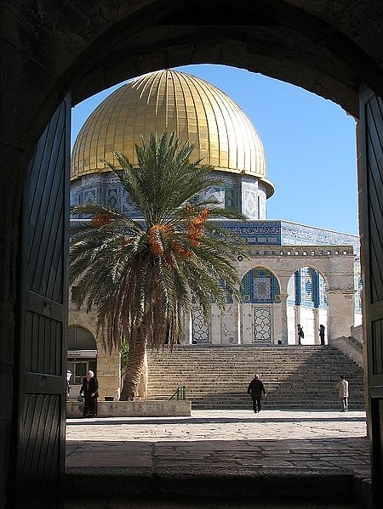
Dome of the Rock viewed through the Old City’s “Cotton Gate”.

Slide 17
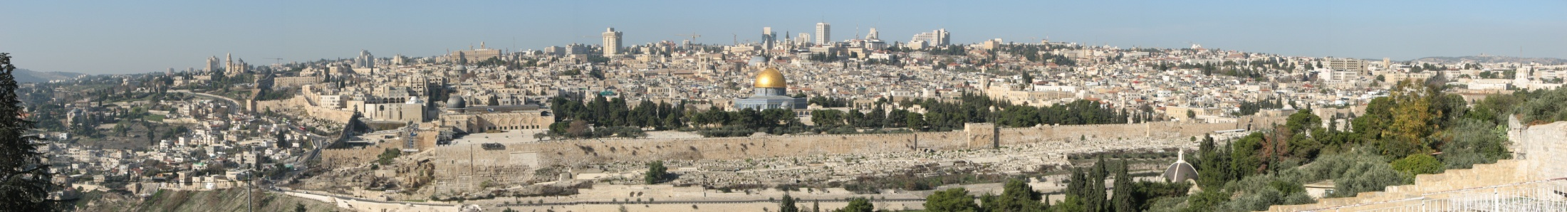
Panoramic view of Jerusalem with the
Dome of the Rock visible.

Slide 18
ISLAM
Confession of Faith
“There is only one God
and Muhammad is his prophet”
Fasting during
Ramadan
Prayer (5 x Day)
Performing the Hajj
(pilgrimage) once in you life
Alms to Poor

Slide 19
The Beliefs and Practices of Islam
The Five Pillars: Muslims must carry out these five duties.
  Statement of Faith to Allah and to Muhammad as his prophet.
  Prayer five times a day. Muslims may use the mosque for this (an Islamic house of worship).
  Giving alms, or money for the poor.
  Fasting between dawn and sunset during the holy month of Ramadan.
  Performing the hajj—pilgrimage to Mecca—at least once in a lifetime.
Notes:
The Five Pillars: Muslims must carry out these five duties.
Statement of Faith to Allah and to Muhammad as his prophet.
Prayer five times a day. Muslims may use the mosque for this (an Islamic house of worship).
Giving alms, or money for the poor.
Fasting between dawn and sunset during the holy month of Ramadan.
Performing the hajj—pilgrimage to Mecca—at least once in a lifetime.

Slide 20
The Beliefs and Practices of Islam
A Way of Life
  Customs and traditions of Islam guide Muslim’s lives.
  A scholar class, ulama, are teachers who apply religion to life. There are no priests.
Notes:
A Way of Life
Customs and traditions of Islam guide Muslim’s lives.
A scholar class, ulama, and teachers apply religion to life. There are no priests.

Slide 21
The Beliefs and Practices of Islam
Sources of Authority
  Original source of authority for Muslims is Allah.
  Qur’an (Koran)—holy book, contains revelations Muhammad claims to have received from Allah.
  Muslims follow Sunna—Muhammad’s example for proper living.
  Guidance of the Qur’an and Sunna are assembled in a body of law called shari’a.
Notes:
Sources of Authority
Original Source of authority for Muslims is Allah.
Qur’an (Koran)—holy book, contains revelations Muhammad claims to have received from Allah.
Muslims follow Sunna—Muhammad’s example for proper living.
Guidance of the Qur’an and Sunna are assembled in a body of law called shari’a.

Slide 22
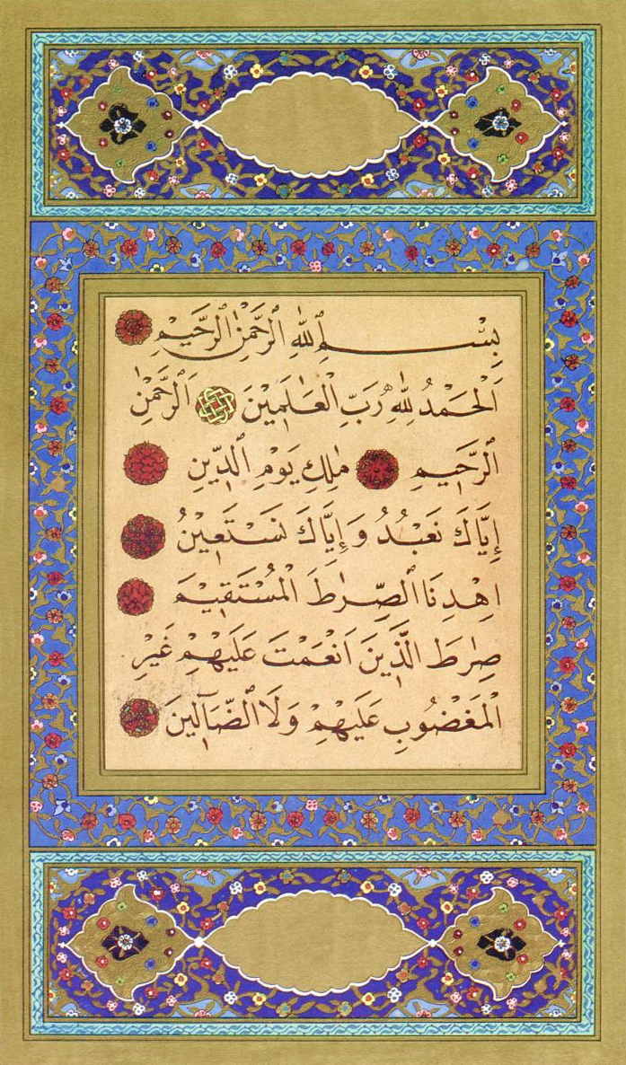
The first verses of the first Sura Al-Fatiha (meaning “The Opener”) from the Qur’an done in beautiful calligraphy and geometric art.

Slide 23
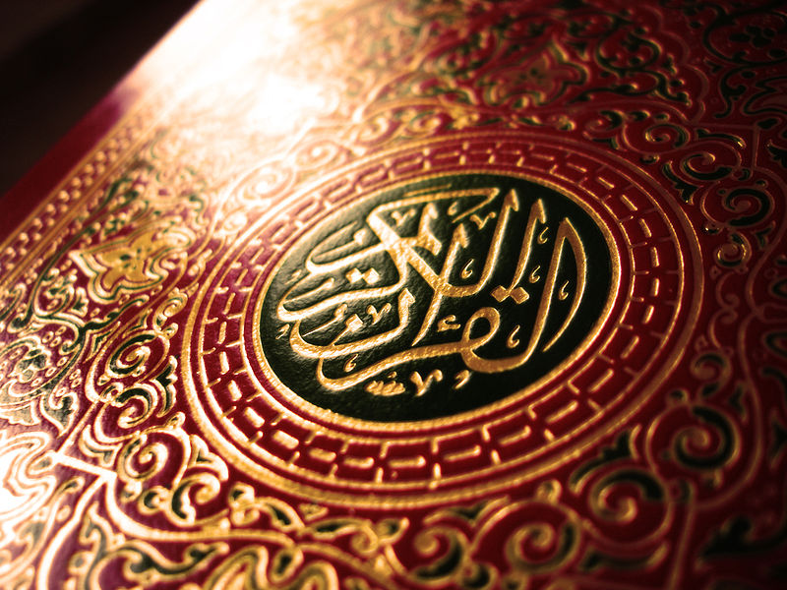
Beautifully decorated Qur’an cover.

Slide 24
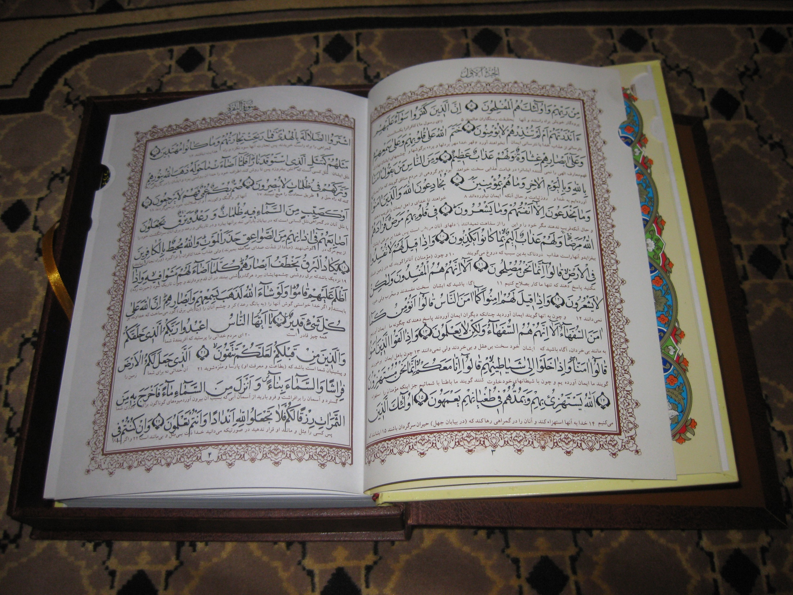
Interlinear edition of the Qur’an with a Persian translation underneath.

Slide 25
The Beliefs and Practices of Islam
Links to Judaism and Christianity
  Muslims believe Allah is the same God worshiped by Christians and Jews.
  Muslims believe the Qur’an, Gospels, and Torah contain God’s will as revealed through others.
  Muslims, Christians, and Jews trace their roots to Abraham.
  All three religions believe in heaven, hell, and a day of judgment.
  Shari’a law requires Muslim leaders to extend religious tolerance.
Notes:
Links to Judaism and Christianity
Muslims believe Allah is the same God worshiped by Christians and Jews.
Muslims believe the Qur’an, Gospels, and Torah contain God’s will as revealed through others.
Muslims, Christians, and Jews trace their roots to Abraham.
All three religions believe in heaven, hell, and a day of judgment.
Shari’a law requires Muslim leaders to extend religious tolerance.

Slide 26
Appendix

Slide 27
Muslim Prayer
Notes:
Source: http://www.bbc.co.uk/religion/galleries/salah/

Slide 28
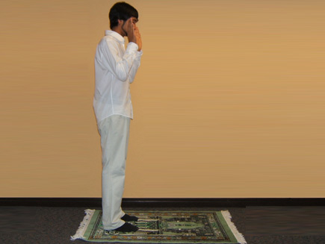
Takbir
Notes:
Takbir
Although Muslims can pray to God at any time or place, and in any language, there are five prayers they are obligated to perform throughout the day. They follow the same pattern so everyone can follow in congregation, and set prayers are always recited in Arabic.
Takbir is entering into the state of prayer by glorifying God. Muslims face towards Makkah and make the intention to pray. To begin the act of prayer, they say 'Allahu Akbar' meaning God is great, raising the hands to the ears or shoulder.

Slide 29
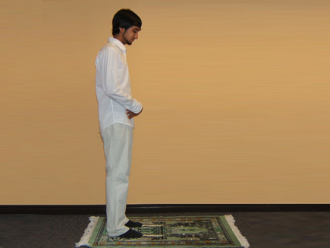
Qiyamm
Notes:
Qiyaam
Muslims place their right hand over their left on their chest or navel while in the standing position. A short supplication glorifying God and seeking His protection is read. This is then followed by Surah Al Fatiha, which is the first chapter in the Qur'an. Verses from any another chapter are then recited.

Slide 30
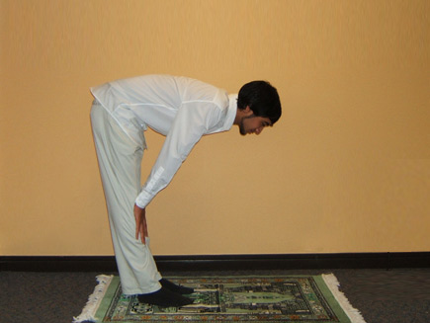
Ruku
Notes:
Ruku
Ruku means bowing. During ruku, Muslims says 'glory be to God, the Most Great', three times.
During prayer, it is forbidden to fidget or look around. Muslims must pray as though they are in the presence of God, and therefore must be in a state of concentration.

Slide 31
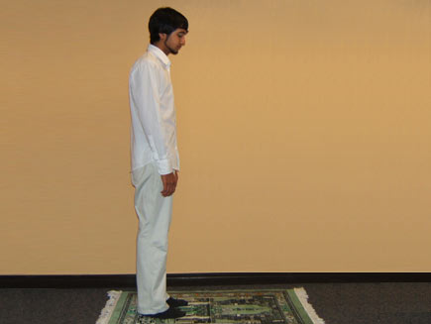
Brief qiyaam
Notes:
Brief qiyaam
While moving into the upright position, Muslims recite 'God listens to the one who praises Him' and while in the standing position, 'To God belongs all praise' then is recited. 'God is Great' is recited again. Hands are loosely at the sides this time.
Each movement is always preceded by the phrase 'God is Great'. This indicates to followers of the prayer that the leader is about to make the next movement.

Slide 32
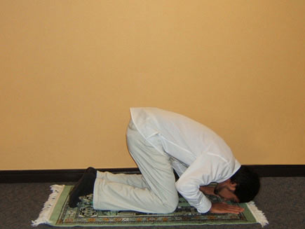
Sujud
Notes:
Sujud
Sujud means to prostrate. While in the prostration position 'Glory be to God, the Most High' is repeated three times. Palms, knees, toes, forehead and nose must be the only body parts touching the ground.
The Prophet said, "The worst thief is he who steals from his prayer." His companions asked, "O Messenger of Allah, how does he steal from his prayer?" He said, "He does not perfect its ruku and sujud".

Slide 33
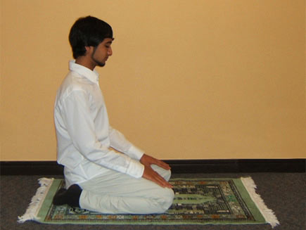
Brief sitting
Notes:
Brief sitting
'God is Great' is recited while moving to the sitting position. Muslims pause here for a few seconds, either staying silent, or reciting a shorter prayer. 'God is Great' is recited once more as the sujud position is taken again.
The Prophet recommended that each movement must last at least the time that it takes for the bones to settle. He compared some people's ruku' and sujud to the way that a crow pecks on the ground, because of the speed at which they perform it. (Ibn Khuzaymah)

Slide 34
Sujud
Notes:
Sujud
This sujud is the same as the first one.
After reciting 'Glory be to God, the Most High', one 'raka'ah', or unit is complete. Each salah has its own number of units though. The shortest prayer, Fajr, has two.
To continue the prayer from the sujud position, Muslims say 'God is Great' and stand up to repeat everything from Surah Al Fatiha, until they reach this sujud again.

Slide 35

Tashahhud
Notes:
Tashahhud
After saying God is Great, Muslims return to the sitting position. They recite a set number of short prayers in Arabic, praising God, and sending peace on the Prophet. They repeat the declaration of faith, raising the forefinger of their right hand, in order to act as a witness.
They then ask God to bestow blessings and peace upon Prophet Abraham and his family, and ask for the same for Prophet Muhammad. Finally, Muslims ask for forgiveness and mercy, and ask God to bless them and their children until the Day of Judgement.

Slide 36
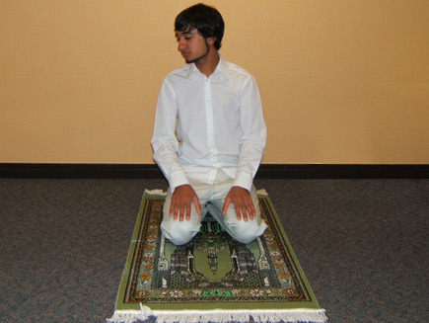
Peace to the right
Notes:
Peace to the right
To end the prayer, Muslims first turn their face to the right saying 'Peace be upon you, and the mercy and blessings of Allah.'
This is said to the Angels which Muslims believe accompany each human being to record their actions.

Slide 37
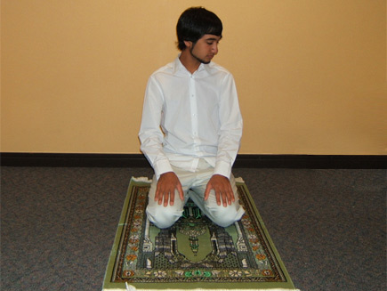
Peace to the left
Notes:
Peace to the left
'Peace be upon you, and the mercy and blessings of Allah' is repeated turning to the left side now.
Muslims believe the Angel on the right side records all good actions and thoughts, while the one on the left records all bad actions.

